Slide 1

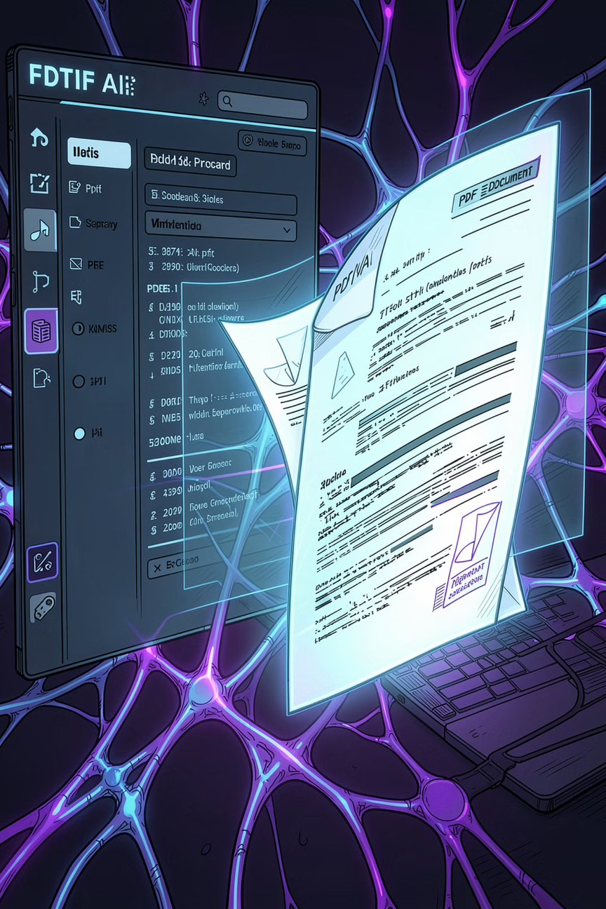

VertexDoc AI
Intelligent PDF Chat Assistant using Retrieval Augmented Generation (RAG)
VertexDoc AI lets users upload PDF documents and chat with them using natural language — powered by RAG, semantic search, and Google Gemini.
Developer: Ankani Balaji · Technology: Python · Flask · Gemini · FAISS · LangChain
Notes:
1

Slide 2
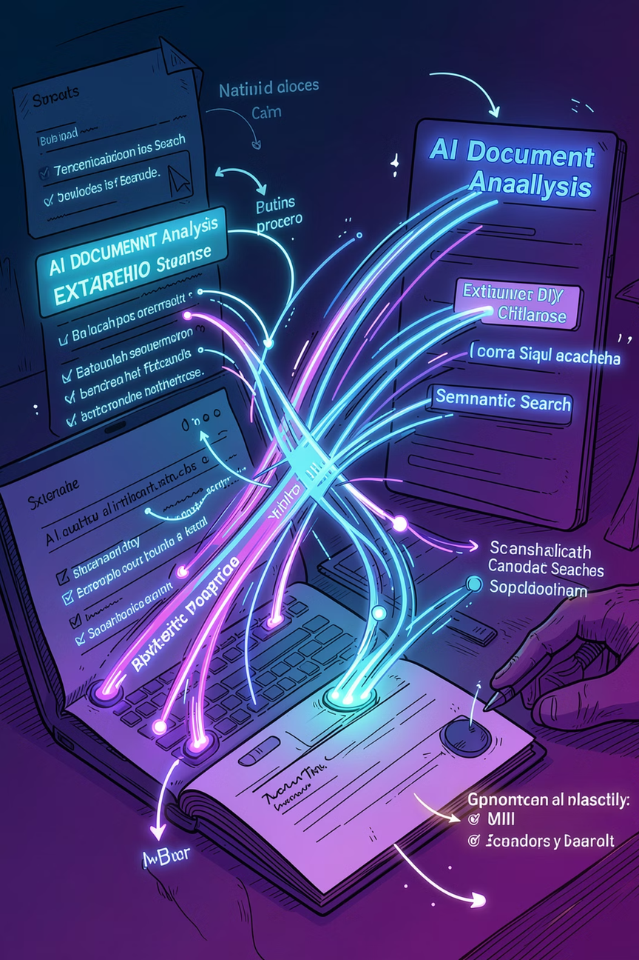
Project Overview
VertexDoc AI enables users to upload PDF documents and interact with them through natural language — replacing manual search with AI-powered, context-aware responses built on Retrieval Augmented Generation.
AI Document Understanding
Parses and interprets PDF content using advanced NLP and embedding models.
Retrieval Augmented Generation
Grounds every response in retrieved document context — no hallucination.
Semantic Search
Understands meaning and intent, not just keywords, for accurate retrieval.
Modular Architecture
Clean separation of concerns across PDF, RAG, chat, and export services.
Notes:
2

Slide 3
Problem Statement
Traditional PDF workflows are slow and imprecise. Long documents require manual scrolling, keyword search misses context, and information retrieval is time-consuming and error-prone.
❌ Traditional Search
✅ AI Semantic Search
Keyword-only matching — no semantic understanding
Manual scrolling through hundreds of pages
No context awareness or intent recognition
Time-consuming and error-prone
Cannot answer complex or multi-part questions
Understands meaning, intent, and context
Instant retrieval of relevant document sections
Conversational, natural language interaction
Grounded, accurate, and hallucination-free
Handles complex, multi-part queries
Notes:
3

Slide 4
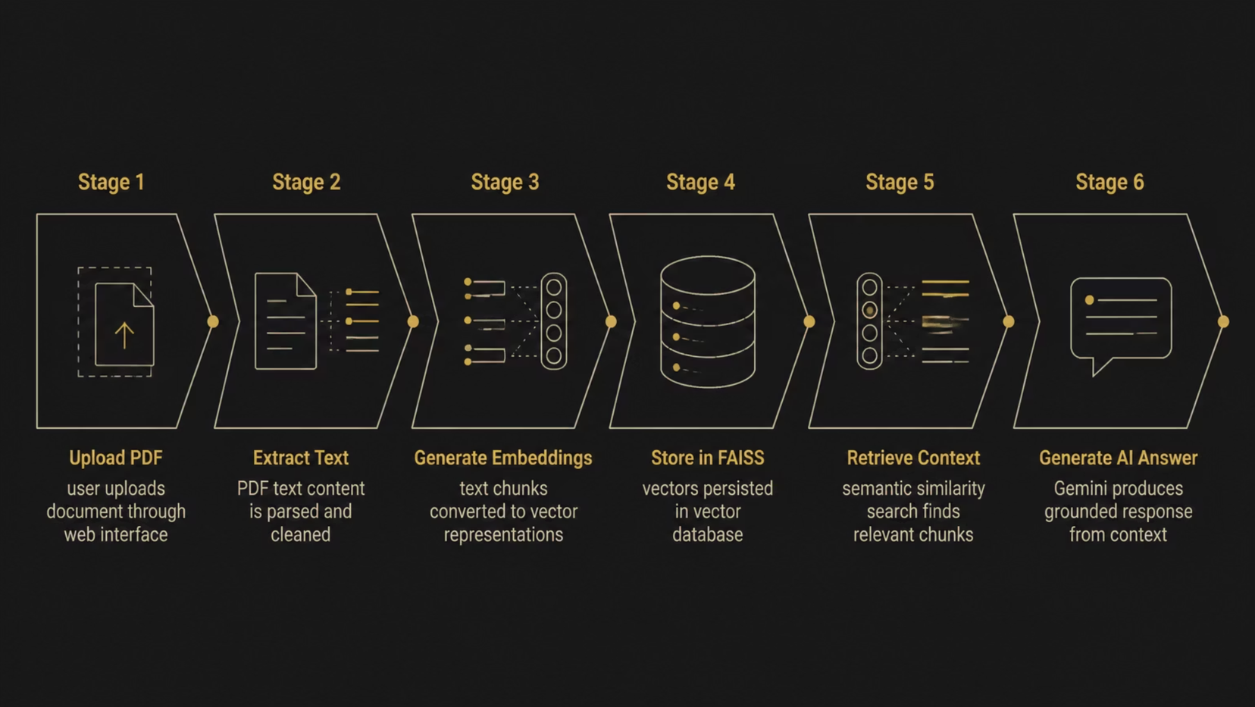
Solution: The VertexDoc AI Pipeline
VertexDoc AI transforms static PDFs into interactive, queryable knowledge bases through a six-stage RAG pipeline — from document ingestion to grounded AI response.
Every answer is grounded in retrieved document context — ensuring accuracy and eliminating AI hallucination at the source.
Notes:
4

Slide 5
Technology Stack
VertexDoc AI is built on a modern, battle-tested stack — each technology selected for its strengths in AI, retrieval, and web development.
Backend
AI Engine
Python · Flask — Lightweight RESTful API with clean routing and modular service architecture.
Google Gemini — Multimodal LLM for summarization, question generation, and grounded responses.
Retrieval Orchestration
Vector Database
LangChain — Orchestrates retrieval chains, prompt templates, and LLM interactions.
FAISS — Facebook AI Similarity Search for high-speed semantic vector lookup at scale.
Embeddings
Frontend
sentence-transformers — Converts text chunks into dense semantic vectors for similarity search.
Bootstrap · HTML · CSS · JS — Responsive UI with chat interface and export capabilities.
Notes:
5

Slide 6

System Architecture
A clean layered architecture separates concerns across ingestion, retrieval, and response generation — ensuring maintainability and scalability.
Architecture Flow
Design Principles
01
Separation of Concerns: Each service has a single responsibility
Stateless API: Flask handles requests without persistent server state
Pluggable Components: Swap embedding models or LLMs independently
Local-First: FAISS runs locally — no external vector DB dependency
User Interface
Browser-based chat and upload
02
Flask Application
REST API and request routing
03
PDF Service
Text extraction and chunking
04
Embedding Model
Sentence-transformers vectorization
05
FAISS Vector Store
Semantic similarity search
06
Gemini API
Grounded AI response generation
Notes:
6

Slide 7
Application Workflow
From first upload to final answer, VertexDoc AI follows a clear eight-stage workflow — each step designed for speed, accuracy, and a seamless user experience.
Upload PDF
Generate Summary
Store Embeddings
Retrieve Context
User uploads a document through the responsive web interface.
Text chunks are vectorized and persisted in FAISS.
Semantic search finds the most relevant document chunks.
Gemini produces a concise document overview for the user.
1
2
3
4
5
6
7
8
Extract Text
Suggest Questions
Ask Questions
Generate Response
PDF content is parsed, cleaned, and prepared for processing.
AI generates relevant questions to guide user exploration.
User submits natural language queries through the chat interface.
Gemini delivers a grounded, cited answer from document context.
Notes:
7

Slide 8








Features
VertexDoc AI delivers a comprehensive feature set — from document ingestion and AI chat to export and conversation history — all within a responsive interface.
PDF Upload
AI Summary
Drag-and-drop or browse upload with file validation.
Auto-generated document summaries via Gemini.
Suggested Questions
Document Chat
AI-curated questions to guide document exploration.
Conversational Q&A grounded in uploaded content.
Semantic Search
Export TXT & PDF
Vector-based retrieval understands meaning, not just keywords.
Export summaries and chat history in multiple formats.
Conversation History
Responsive UI
Full session history maintained throughout the interaction.
Works seamlessly across desktop, tablet, and mobile.
Notes:
8

Slide 9
Project Structure & Core Modules
A clean, modular codebase with dedicated services for each domain — enabling independent testing, maintenance, and extension.
Folder Hierarchy
Core Service Modules
vertexdoc-ai/
├── app.py
├── config.py
├── routes/
├── services/
│ ├── pdf_service.py
│ ├── summary_service.py
│ ├── question_service.py
│ ├── rag_service.py
│ ├── chat_service.py
│ └── export_service.py
├── templates/
├── static/
├── uploads/
├── vector_store/
└── README.md
PDF Service
Summary Service
Question Service
Extracts and chunks text from uploaded PDFs.
Generates concise document overviews via Gemini.
Creates AI-suggested questions for exploration.
RAG Service
Chat Service
Export Service
Manages embedding, storage, and vector retrieval.
Orchestrates the full RAG pipeline for user queries.
Outputs summaries and history as TXT or PDF.
Notes:
9

Slide 10

AI & RAG Pipeline
The RAG pipeline ensures every response is grounded in retrieved document context — eliminating hallucination by design.
User Question
Context Assembly
Natural language query submitted
Chunks formatted into a prompt
Grounded Response
Vector Search
FAISS retrieves top relevant chunks
Gemini generates cited answer
No hallucination. Answers are generated exclusively from uploaded document context — the retrieval layer acts as a grounding constraint on the LLM.
Challenges & Solutions
Testing Results
Large PDFs
PDF Upload
Text Extraction
Chunking + FAISS enables efficient processing of lengthy documents.
✅ PASS
✅ PASS
AI Hallucination
Summary
Question Generation
RAG restricts generation to retrieved context only.
✅ PASS
✅ PASS
API Errors
Chat
Export TXT
Graceful exception handling with user-friendly fallbacks.
✅ PASS
✅ PASS
Export PDF
Invalid File Handling
✅ PASS
✅ PASS
Notes:
10

Slide 11

Thank You for
Your Attention

